Slide 1
DEBER TABOR UNIVERSITY FACULITY
OF TECHNOLOGY COMPUTER SCIENCE
DEPARTMENT FINAL PROJECT
ON
HIBRET HOTEL ONLINE CINEMA TICKET
BOOKING SYSTEM

Slide 2
Group members are:
Name Id
1,Amelewerk Debas-------------------------------------------2211/06
2, Andnet Teka-------------------------------------------------2213/06
3, Manamno Mihret-------------------------------------------2269/06
4, Mengesha Molawork---------------------------------------2326/06
5, Mequant Bogale--------------------------------------------2274/06
6, Yishak Yiferu------------------------------------------------2315/06
Advisor: Mr. Sissay Yema

Slide 3
Content
Introduction
The entertainment industry is one of the most profitable sectors.
The only problem is how people get to know about the movies.
How they can get tickets.
Hibret hotel Cinema ticket reservation system aims.
To provide suitable environment .

Slide 4
The Existing system study
The current system of Hibret Hotel cinema is entirely manual .

Slide 5
Overview of the proposed system
Our proposed system would be web based application.
Reserve seats and ticket for customers.
Customer can pay money online.

Slide 6
Objective and Scope General objective of the system changing the manual system to online ticket reservation system. Specific Objectives of the system advertising the cinema service for customers. announce the total number of free seats. Scope The project is limited to Hibret Hotel Cinema customer can pay money and reserve ticket online.

Slide 7
Statements of the problem :
The absence of online ticket reservation system and advertisement
There are a number of employee

Slide 8
Methodology Data gathering method: Direct observation,Questioners and Interview Design methodology: We use the iterative model to design our system Testing methodology: Unit testing Integration Testing System testing

Slide 9
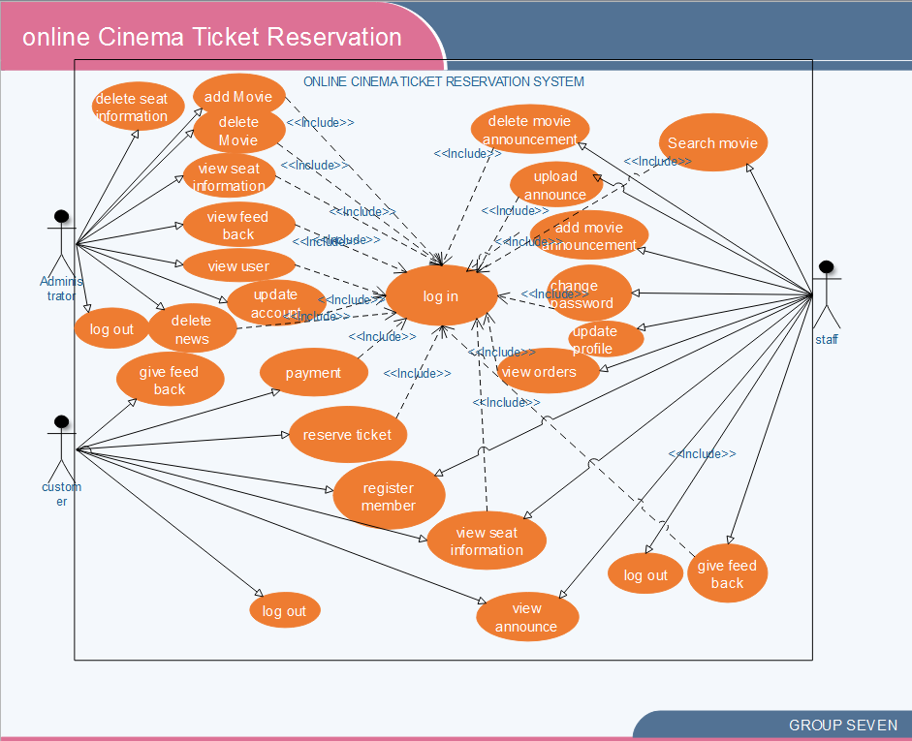
Functional requirement
Use case diagram

Slide 10
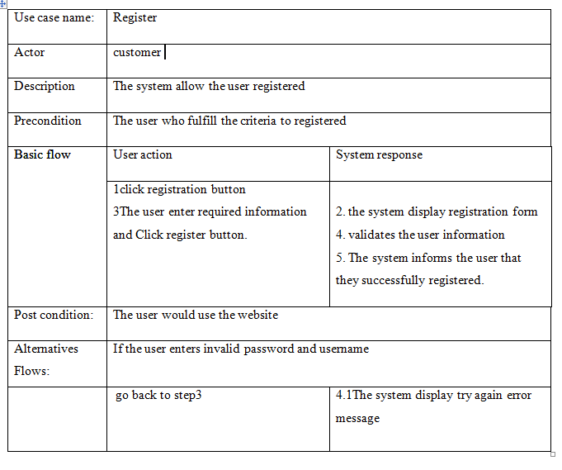
Use case description

Slide 11
Non Functional Requirements
Security:
Performance
Availability
usability

Slide 12
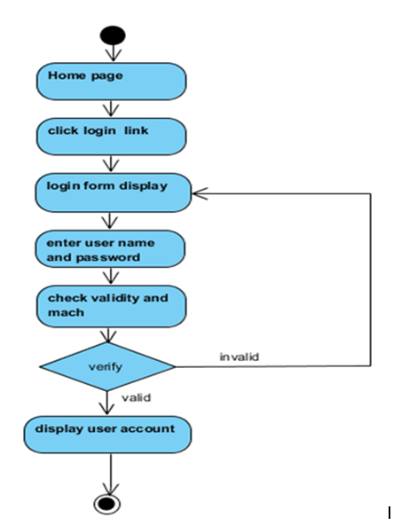
Log in activity diagram

Slide 13
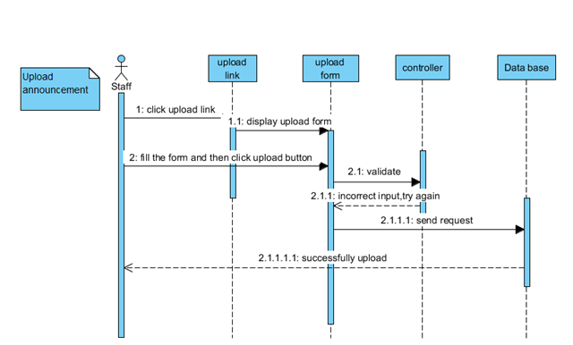
Upload announcement sequence diagram

Slide 14
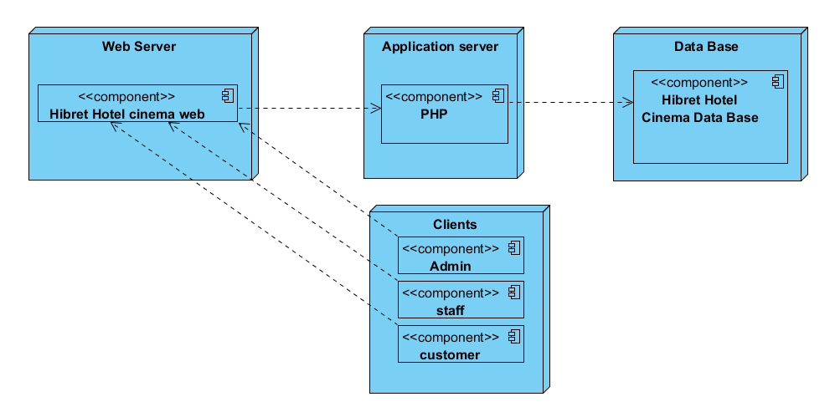
Deployment diagram

Slide 15
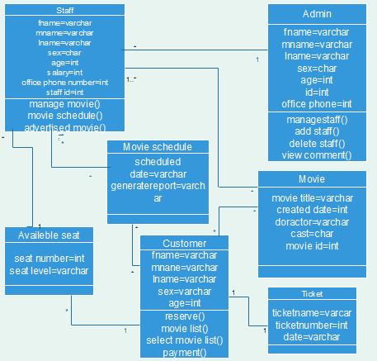
class diagram

Slide 16
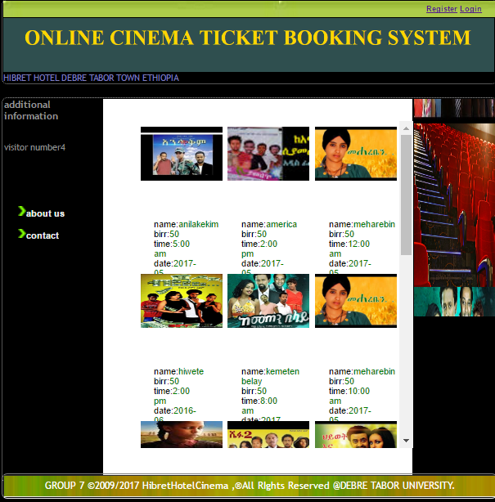
Sample user interface

Slide 17
Algorithms for displaying customer registration
Click registration link then,
Display the registration form.
Fill user id, first name, last name, gender, email, password, re-enter password, mobile number, country, city and press submit button.
If the filled input is valid,
Display member login page.

Slide 18
Cont…….
Else
Display error message.
Re-fill again.
Display member login page.
End.

Slide 19
Recommendation and limitation
we have tried to automate is not the whole system .because time and budget.
Ticket cancelation impossible.
The system support only English language.
Receipt of payment and seat reservation are not .
Automatic generation of seats number during reservation is not possible

Slide 20
Conclusion
The software that we developed would benefit for Hibiret cinema w.
would minimize the number of employees.
provide flexible service to user and makes the organization profitable
They can easily announce their service to customer to increase their customer in number.
improved manual system and safety for customer’s service by making computerized and online ticket reservation.

